Slide 1




STUDENT NAME: SHEEBA MARY.L
REGISTER NO: 422200042
DEPARTMENT: B. COM[ISM]
COLLEGE:S.I.V.E.T COLLEGE

Slide 2
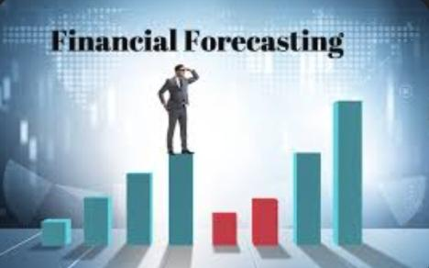
PROJECT TITLE
FINANCIAL FORECASTING IN EXCEL

Slide 3

AGENDA
Problem Statement
Project Overview
End Users
Our Solution and Proposition
Dataset Description
Modelling Approach
Results and Discussion
Conclusion
3/21/2024 Annual Review

Slide 4

PROBLEM STATEMENT
Financial forecasting refers to the process of estimating a company's future financial health by examining historical data provided by various financial disclosures, financial statements, and positioning statements

Slide 5

PROJECT OVERVIEW
The process of using past financial data and current market trends to make educated assumptions for future periods. It is an important part of the business planning process and helps inform decision-making. Effective forecasting relies on pairing quantitative insight with creative evaluation.

Slide 6

WHO ARE THE END USERS?
In finance, companies use forecasting to estimate earnings or other data for later periods. Traders and analysts use forecasts in valuation models, to time trades, and to identify trends.26 Jun 2

Slide 7
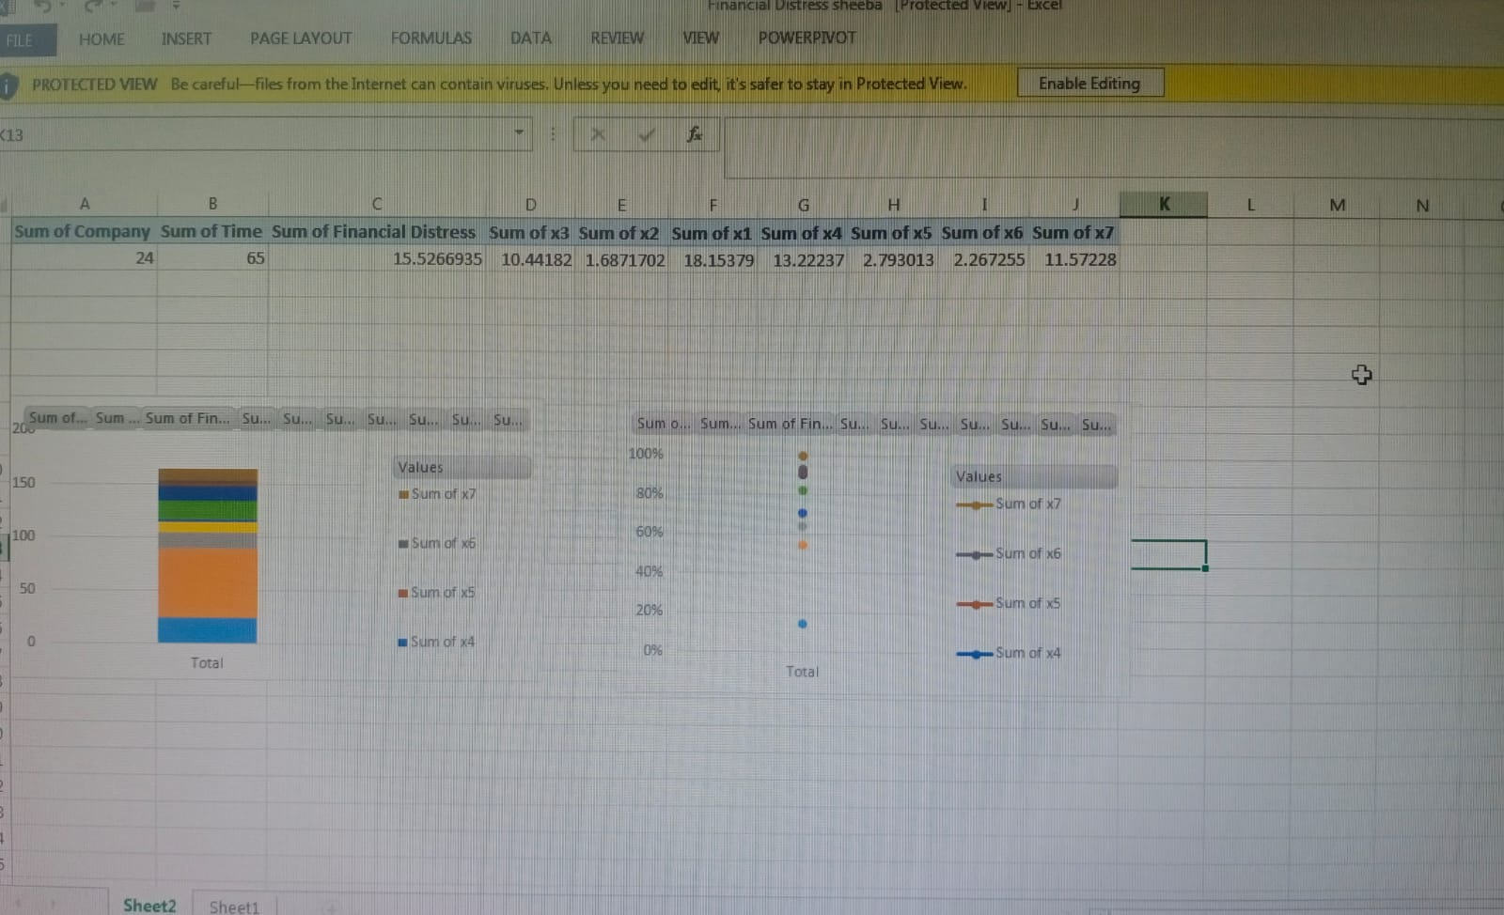
OUR SOLUTION AND ITS VALUE PROPOSITION

Slide 8
Dataset Description
Financial forecasting examines historical data to estimate a company's future financial outcomes and looks at how actual performance and changes are guiding future outcomes.

Slide 9
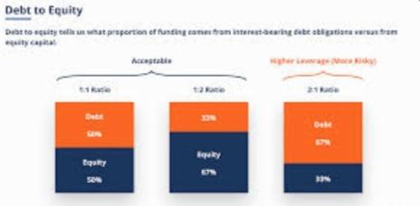
THE "WOW" IN OUR SOLUTION
3/21/2024 Annual Review
9

Slide 10
MODELLING
10

Slide 11
RESULTS
11

Slide 12
conclusion
In conclusion, we can say that demand forecasting holds paramount importance in modern business strategies. Companies can optimize their operations, reduce costs, and maintain customer satisfaction by accurately predicting customer preferences and market trends.

